Slide 1






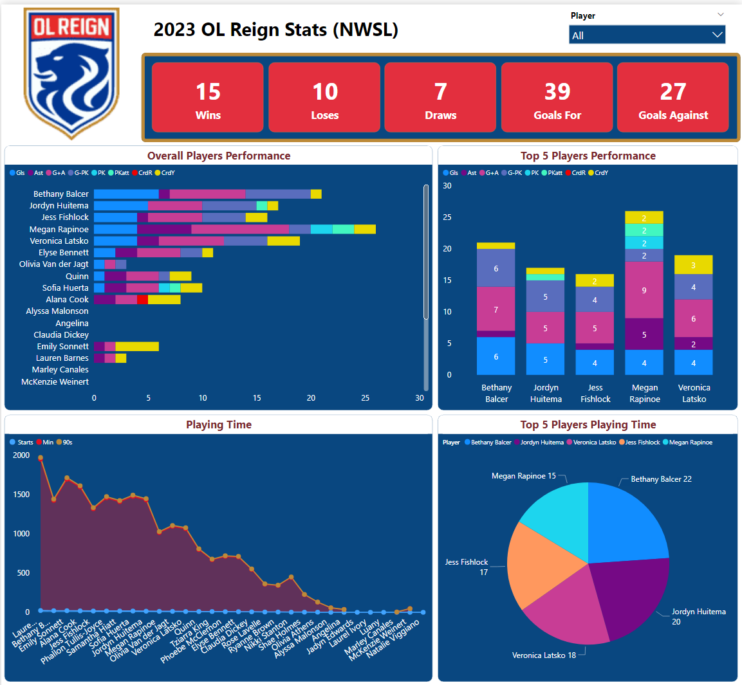

OL Reign Power BI Dashboard Analysis
By Fanuel Abraha
Prof. Nancy Kool
+ Objective
+ Methodology
+ Technologies
Develop and implement an interactive and user-friendly Power BI dashboard for OL Reign, with the aim of providing fans and analysts a comprehensive visual representation of the team's performance, fostering engagement, and serving as a prototype for a broader sports analytics' platform.
Data Collection
Data Processing and Transformation
Coding for Data Integration
Power BI Dashboard Development
Future Expansion Planning
+ Benefits
+ Results
Engaging Fan Experience: The Power BI dashboard enhances fan interaction, offering an immersive experience for understanding OL Reign's performance.
Informed Decision-Making: Real-time data empowers decision-makers, aiding in strategic choices for team performance.
Scalable Sports Platform: Expanding to a website and app creates a scalable platform for multiple sports teams, fostering a broad community of engaged sports enthusiasts.
Centralized Data Access: Addressing a user-friendly gap, the project provides a centralized platform for fans to access detailed information about their favorite teams.
+ Relevant Courses
CSS 301 Technical Writing
CSS 475 Database Systems
CSS 360 Software Engineering
CSS 370 Analysis and Design

